Slide 1
Overview of Presentation
Grade Level Reading Campaign
Reading Realities for All Children: Facts are Facts
“Literacy for Littles” with Hearing Loss: Things to Consider
Literacy Definitions
Literacy Development
Effective Reading Strategies for Parents Curriculum
“Intentional Shared Storybook Reading” teaches
Print Knowledge
Word Knowledge
Phonological Knowledge
Alphabetic Knowledge
Narrative Knowledge
World Knowledge
Literacy Curriculums

Slide 2
Why This Presentation?
Reading is foundational to academic success
Up through 3rd grade, children learn to read; After 3rd grade, children “read to learn”
A child who is reading at grade level by 3rd grade is more likely to succeed in later grades and master complex subject matter
Children who are reading proficiently by third grade are 4 times more likely to graduate high school on time
We want to show you what it takes to develop grade-level literacy skills and how it’s done

Slide 3
The Campaign
The Campaign for Grade-Level Reading: 3rd Grade Reading Success Matters!
http://gradelevelreading.net/
Research shows that proficiency in reading by the end of third grade enables students to shift from learning to read to reading to learn, and to master the more complex subject matter they encounter in the fourth grade curriculum. Most students who fail to reach this critical milestone falter in the later grades and often drop out before earning a high school diploma. Yet two-thirds of U.S. fourth graders are not proficient readers, according to national reading assessment data. This disturbing statistic is made even worse by the fact that more than four out of every five low-income students miss this critical milestone.
About 67 percent nationwide and more than 80 percent of those from low-income families—are not proficient readers by the end of third grade

Slide 4
The Campaign
As early as 18 months, children in low-income families begin to fall behind in vocabulary development and other skills critical for school success.
61 Percent of children in low income families have no children’s books at home.
Children in low-income families hear as many as 30 million fewer words than their more affluent peers.
By age 2, poor children are already behind their peers in listening, counting, and other skills essential to literacy.
A child’s vocabulary, as early as age 3, can predict third grade reading achievement.
By age 5, a typical middle-class child recognizes 22 letters of the alphabet, compared to 9 for a child from a low-income family.
https://gradelevelreading.net/our-work/school-readiness

Slide 5
Fueling the Campaign
Goal: By 2020, a dozen states or more will increase, by at least 100%, the number of low-income children reading proficiently at the end of third grade
Funding: https://gradelevelreading.net/about-us/campaign-investors
Partners: https://gradelevelreading.net/about-us/campaign-partners
Grade-Level Reading Communities Network
https://gradelevelreading.net/our- network/participating-communities

Slide 6
Where Do Children Who Are Deaf or Hard of Hearing Fit Into This Equation?
Children who are deaf or hard of hearing have the same need to read and stay on course as children who are not deaf or hard of hearing….of course!
Birth to Three and Pre-School:
Because of decreased auditory access: language, vocabulary, pre-literacy and literacy activities may not be as available to children who are deaf or hard of hearing
School-age:
Because of decreased auditory access coupled with the fast-paced classroom, increased rate of learning, reading to learn, and expectations to meet outcomes, many children who are deaf or hard of hearing are likely to need adaptations to their education in the form of one or more of the following: classroom accommodations, modifications, related services and/or supplementary aids and services to truly have access to instruction.

Slide 7
Pause for Seriously Important Information
Supports
Modifications
Accommodations
Related Services
Supplementary Aids and Services
https://successforkidswithhearingloss.com/for-parents/supports-modifications-accommodations-for-students/

Slide 8
The Campaign for Grade-Level Reading 3rd Grade Reading Success Matters
Betty Hart and Todd R. Risley (1995) published a study that highlighted the close link between children’s academic success at ages 9 and 10 and their verbal interaction with their parents during the first years of life which became:
The 30 Million Word Gap
The Role of Parent-Child Verbal Interaction in
Language and Literacy Development

Slide 9
Because of Hart & Risley and other researchers…
Parent-child verbal interaction is strongly associated with the development of children’s vocabulary and emergent literary skills.
Parent- child verbal interaction is associated with development of conceptual knowledge (e.g. vocabulary, understanding of narrative and story structure) which together with subsequent development of decoding skills (e.g. phonological awareness, letter knowledge) leads to literacy.
Researchers link the achievement gap between high and low SES
Verbal interaction between parent and child is part of a constellation of income-associated home characteristics and family practices that influence reading readiness.
http://www.aecf.org/resources/the-30-million-word-gap/

Slide 10
How Do We Get Involved in 3 by 3?
Beginning in Infancy
Purposely recommend ways to create literacy-rich environments
High expectations for all children
Designing goals consistent with curricular standards
Attending to benchmarks
Measuring progress
Communicating expectations
Recruiting others to help

Slide 11
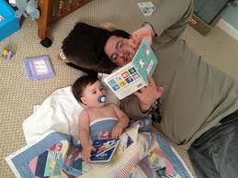
Reading Realities for All Children: Facts are Facts
Notes:
Velvet starts

Slide 12
Reading Realities for All Children
A child who has been read to from a young age:
Is better prepared to learn to read
(National Reading Panel, 2000)
Has heard more than 30 million words by age
3 and has a vocabulary of 20,000 words by age 6
Hart and Risley, 1995, Meaningful Differences in the Everyday Experiences of Young Children
Scores highest on reading, math, and general knowledge tests
Christian, Morrison, and Bryant, 1998 Predicting Kindergarten Academic Skills

Slide 13
Reading Realities for All Children
The Matthew Effect (Stanovich, 1986)
In reading, the rich get richer, the poor get poorer
Early success in reading, leads to later success in cognition, learning, and vocabulary
The gap grows between strong and weak readers
Beginning of first grade: gap of 12.8 words
End of first grade: gap of 49.8 words
End of middle school:
Good readers read 10,000,000 words= large vocab
Poor readers read 100,000 words

Slide 14
Reading Realities for All Children
24% of US 4th graders read proficiently; 37% do not have basic reading skills
Good readers in 5th grade may read 10 times as many words as poor readers over a school year
The average middle-class first grader has been read to more than 1250 hours
For some children in low-income families, the comparable figure is 25 hours
National Reading Panel, 2006

Slide 15
Reading Realities for All Children
Children from low-income families typically enter school a full year and a half behind their middle-class peers in language ability
Low-income families children are exposed to 1/3 the verbiage that high SES children are exposed
The average student learns 3,000 words per year in the early school years (8+ words per day)
1st and 2nd grade children need to learn 800+words per year or 2 per day
In 1999, only 53 percent of children aged 3-5 were read to daily by a family member
Reading 1min/day: exposed to 8000 wds/yr
Reading 5min/day: exposed to 282,000 wds/yr
Reading 20min/day: exposed to 1,800,000 wds/yr
Laura Justice, 2005

Slide 16
Reading Realities for All Children
Phonological Awareness has been associated with the ability to read and to spell
Child’s phonological awareness upon entering school is the strongest predictor of success for reading (Adams, 1990, Stanovich, 1986)
Phonological awareness is fundamental to spelling (Goswami and Bryant, 1990)

Slide 17
National Early Literacy Panel
Panel convened in 2002
Reviewed 8000 articles, used 500 for their meta-analyses
Final Report: Developing Early Literacy: Report of the National Early Literacy Panel, 2008
Identified 11 skills linked to early literacy achievement and predictive of achievement at the end of kindergarten or beginning first grade

Slide 18
Precursor Literacy Skills
6 had a medium to large predictive relationship
Alphabet Knowledge
Phonological Awareness
Rapid Automatic Naming (RAN) of letters or digits
RAN of objects or colors
Letter Writing
Phonological Memory
5 were moderately correlated with later measures of literacy development
Concepts about Print
Print Knowledge
Reading Readiness
Oral Language
Visual Processing

Slide 19
Precursor Literacy Skills Defined
Alphabet Knowledge: knowledge of the names and sounds associated with printed letters
Phonological Awareness: ability to detect, manipulate, or analyze the auditory aspects of spoken language, to distinguish or segment words, syllables, or phonemes (independent of meaning)
RAN of letters or digits: ability to rapidly name a sequence of random letters or digits
RAN of objects or colors: ability to rapidly name a sequence of repeating random sets of pictures of objects or colors
Letter Writing: ability to write letters in isolation on request or to write one’s own name
Phonological Memory: ability to remember spoken information for a short period of time

Slide 20
Precursor Literacy Skills Defined
Concepts about Print: knowledge of print conventions
Print Knowledge: a combination of elements of AK, concepts about print, and early decoding
Reading Readiness: a combination of AK, concepts of print, vocabulary, memory, and PA
Oral Language: ability to produce or comprehend spoken language, including vocabulary and grammar
Visual Processing: ability to match or discriminate visually presented symbols

Slide 21
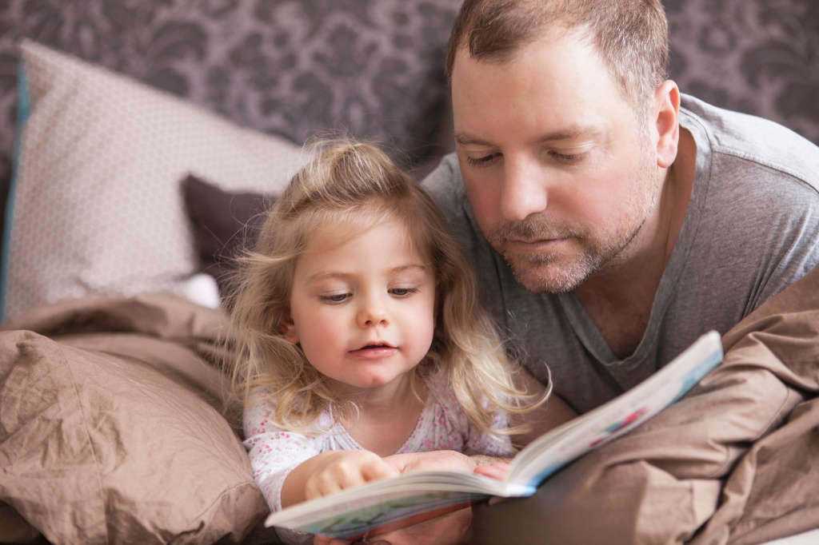
Kids and Family Reading Report
In Spring 2010, Scholastic, in conjunction with Quinley Research and Harrison Group, conducted a survey to examine family attitudes and behaviors regarding reading books for fun in today’s digital age.
The key findings of this research, based on a nationally representative sample of 1,045 children age 6–17 and their parents (2,090 total respondents) are as follows:

Slide 22
The frequency of reading aloud to young children has increased since 2014 Percentage of Parents Who Say Their Child is Read Books Aloud 5–7 Days a Week

Slide 23
The frequency of reading aloud still drops significantly after age 5 and again after age 8. Percentage of Parents Who Say Their Child is Reading Books Aloud 5–7 Days a Week Base: Parents with Children Ages 0–11

Slide 24
On average, families across America with kids ages 0–17 have 104 children’s books in their homes. Average Number of Children’s Books in Home Difference of 60 books from low to high income

Slide 25
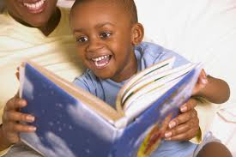
“Literacy for Littles” with Hearing Loss: Things to Consider
Read to Me

Slide 26
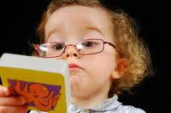
“Literacy for Littles”: Hearing Loss and Literacy
Read to Me!
Notes:
Velvet starts

Slide 27
Hearing Loss and Literacy
Reading problems stem from:
Phonological awareness/phonemic awareness and decoding difficulties
Inadequate language (reduced content, form and use)
Lack of experiences and world knowledge/current events knowledge
Difficulties understanding another’s perspective, dialogue and narrative language skills
Lack of exposure to books being read to them/book knowledge

Slide 28
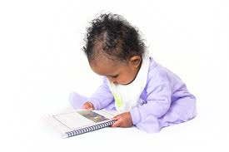
How can we improve literacy?
“ We need to catch them
before they fall”
Torgensen,1999

Slide 29
Hearing Loss and Literacy
Teach listening first:
to promote neural connections within the auditory cortex
To facilitate language and reading competence.
Phonemic and Phonological Awareness training begins in infancy.
Hearing does NOT equal Listening!

Slide 30
Literacy Definitions

Slide 31
Literacy Definitions
Metalinguistic Awareness: think about, talk about, and manipulate language; the language of learning
Plays an important role in phonological, word, syntactic, pragmatic and meta-textual awareness
Phonological Awareness: large units such as words, syllables, AND phonemes; one aspect of metalinguistic awareness
Sentences: made of words
Words : made up of syllables and sounds
Syllables: made up of sounds
Letters: represent sounds
Phonemic Awareness: speech sounds only; one aspect of phonological awareness
Spoken words are sequences of phonemes which are the smallest units of speech

Slide 32
A Simplified View of Reading
Decoding + Comprehension = Reading
Decoding Skills allow information to “get in”
Print knowledge
Phonological and Phonemic Awareness
Phonics and the Alphabetic Principle
Language Comprehension allows us to “make sense of it”…once it is “in”
Grammar
Vocabulary
Narrative skills
Metalinguistic awareness

Slide 33
A Simplified View of Reading
Non-fluent Reader
Mental effort on DECODING
Negatively impacts Comprehension
Fluent Reader
Decoding is automatic, fast and accurate
Mental effort on COMPREHENSION
The fluent reader can accurately decode and comprehend at the same time with automaticity.

Slide 34
A Complex View of Reading
It’s not so simple after all…

Slide 35
Model of the Reading Process Anne Van Kleek,1998
Reading Success
Context Processor
Phonological Processor
Orthographic Processor
Meaning Processor
World Knowledge,
Syntax
Reasoning
Book Conventions
Narrative Development
Vocabulary Development
Word Awareness
Syllable Segmentation
Rhyming
Phoneme Segmentation
Letter Knowledge
Print Conventions
Adams’ (1990)
Notes:
A structure for organizing ways of thinking about the relationship of early language necessary for successful communication and language necessary for preliteracy skills and later literacy skills
Each processor contains subskills that aid in preliteracy development

Slide 36
1) Context Processor
The processor in charge of constructing a coherent, ongoing interpretation of the text
Focus on the meaning utilizing
World knowledge
Syntax
Narrative Development
Book Conventions
Reasoning
This processor allows them to attach meaning to print at an early age
Notes:
Focus on meaning rather than form
World knowledge-the child can understand what he reads by drawing on experiences from his world and also learn about the world through reading
Syntax-Most important during self reading, interpreting the text by understanding relationships between grammar, phrases and clauses
Narrative development-story grammar and cohesion tieing the story together, allowing he child to connect together and understand the text in more than one sentence at a time
Book Conventions: rules for interacting with books- as simple as books are for reading, pictures are representations of things, pictures are for naming, pictures can represent events, book events occur outside real time, books can represent a fictional world
Reasoning: Children begin thinking about how and why events take place in stories, they relate books to past experiences and make judgments about events occurring in the book. In print rich homes, this skill is often developed before children have learned to decode and read independently. Later, this skill will play an important role when the curriculum switches from “learning to read” to “reading to learn”
This could help ensure enjoyment of the process of learning to read and later becoming a successful reader

Slide 37
2) Meaning Processor
Focus on Meaning utilizing
Vocabulary Development
Word Awareness
Segmentation-word boundaries, awareness that words are a unit of language
Word Consciousness-words are separate from their referents
Book reading and vocabulary development are mutually promoting
Notes:
Word consciousness- for example, Caterpillar is a long word because it has lots of letters vs. Train is a long word because trains are very long
Can be thought of as general vocabulary development, as well as learning specific to metalingustic terms unique to books and reading. Words that tend to develop early are book, page, read and story. Later developing are letter, number, word and capital
Children’s vocabulary helps them understand books read to them and their vocabulary is further developed by books read to them

Slide 38
3) Phonological Processor
Phonological awareness is highly correlated with early reading ability
Subskills include
Syllable segmentation
Ba/by, can/dy, com/pu/ter
Rhyming
Onset and rime- p/op, h/op, t/op, c/op
Phoneme segmentation
Relies on phonological awareness or conscious awareness of the sound component of words
Notes:
Syllable segmentation is the earliest to emerge, followed by the subsyllabic units of onset and rime and phonemic awareness needed for phoneme segmentation is the most difficult and last aspect of phonological awareness to develop.
Rhyming could be considered segmentation at the level of the onset and rime

Slide 39
4) Orthographic Processor
In charge of individual letter recognition and the associative links between and among them
Over time, the linkages allow the input to consist of simultaneously processed letter sequences
Subskills
Print Conventions
We read the print from left to right, top to bottom and front to back
Letter Knowledge
Knowing the names, shapes and sounds of letters
A strong predictor of speed in learning to read
Notes:
At the most basic level, knowledge of print conventions would include knowing that it is print, and not pictures that one reads. Print conventions also includes print directionality, left to right and top to bottom and front to back. Generally preschoolers exposed to books will easily pick up on these rudimentary conventions.
Letter knowledge is the anchor for the entire reading system so it is benefical to preschoolers to solidly learn or even over-learn letters

Slide 40
Integration of the Processors
Research suggests that the processors eventually integrate and that this integration is fostered by two stages of pre-literacy development to be emphasized sequentially but separately
Stage One: Emphasizing Print Meaning
Stage Two: Emphasizing Print Form and Early Form-Meaning Correspondence
To become a successful and fluent reader, a combination and integration of all processors is necessary
Notes:
The meaning and context processors are meaning-oriented
The orthographic and phonological processors are form-oriented
We should emphasize print meaning and form sequentially, with the meaningful nature of print being emphasized first

Slide 41
Phonological Awareness Goals
Recognize and produce rhyming words
Orally segment sentences into words
Orally blend root words to form compound words
Isolate first or last root words in compound words
Orally delete root words into compound words
Orally segment words into syllables
Identify # of syllables
Orally blend syllables into words
Isolate initial, final, medial syllable
Delete initial, final, and medial syllables
Isolate initial, final, and medial phonemes in words

Slide 42
Phonological Awareness Goals
Segment words into phonemes
Blend phonemes into words
Delete initial, final and medial phonemes from words
Substitute initial, final, and medial phonemes in words
Say the sounds of consonants /short and long vowels
Say sounds of consonants and vowel digraphs, dipthongs, blends, and r-controlled vowels
Decode VC,CVC,CCVC,CVCC,CCVCC words
Read and spell words

Slide 43
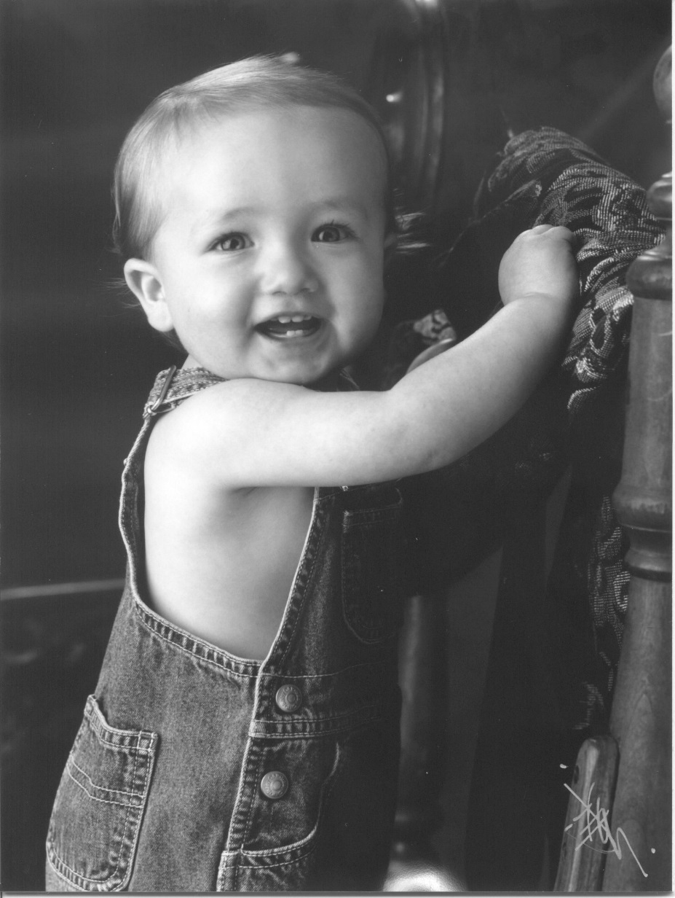
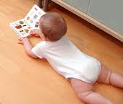
Literacy Development Loving to Read! Learning to Spell and Write!
It starts at a young
age!

Slide 44
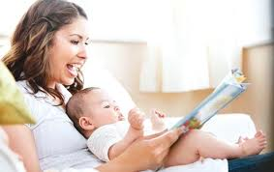
Birth to 12 months Literacy Development
Reaches for book
Puts books to mouth
Sits in lap with head steady
Turns pages with help
Looks at pictures
Vocalizes and pats pictures
Prefers simple pictures, bright colors, and faces
Point to words and pictures while naming

Slide 45
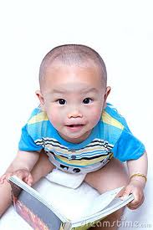
12-18 months Literacy Development
Sits without support
Carries books
Holds book with help
Turns board pages, several at a time
Points at pictures with one finger
Make same sound for certain pictures
Points when asked “Where’s the -----”
Turns book right side up
Gives book to adult to read

Slide 46
18-24 months Literacy Development
Turns board book pages one at a time
Names familiar pictures
Fills in words to familiar stories
“reads” to dolls or stuffed animals
Recites part of well-known stories
Attention span is variable, may not sit through entire story
Understands vocabulary (book, cover, story, beginning, end, the end)
Begins to ask questions (What’s That?)(What does this say?)

Slide 47
24-36 months (2-3 years) Literacy Development
Learns to handle paper pages
Goes back and forth in books to find favorite pictures
Recites whole phrases, sometimes whole stories
Protests when adult says a word wrong in familiar story
Coordinates picture with text
Reads familiar books to self
Explores print and recognizes some words in stories and environmental print
Shows top to bottom and left to right orientation
Recognize beginning and ending of stories
Points to title and author
Recognizes favorite books and finds them
Asks “what does this word say?”

Slide 48
37-48 months (3-4 years) Literacy Development
Wants to learn to read and reads simple books independently
Recognize a few sight words and many environmental print words
Notices differences in print (egg vs eggs)
Use knowledge of alphabet to find words in books
Begins to decode simple words
Imitates adult reading with eye movements, and tone of voice
Understands reading for pleasure vs. for information
Understands concepts of author, title, illustrator, simple plot lines, making predictions, cause and effect
Develops directionality
Print is read, pictures support the print
Responds to emotional content of story
Differentiates letters from words from numbers
Recognizes rhymes and beginning sounds in words

Slide 49
49-60 months (4-5 years) Literacy Development
Wants to decode words
Identifies the cover, the title, and where the author and illustrator information is located
Holds book properly, turns pages, moves eyes, follows print with finger
Storybooks are different than newspapers
May not understand “silent reading”
Demonstrates understanding of plot and sequences of stories
Retells stories with structure and future tense
Understands letters, words, sentences and punctuation
Identifies all letters and reads many words
Understands rhyme and syllables

Slide 50
Kindergarteners
Phonological Awareness:
Rhyming ( given a word can produce a rhyming word)
Clapping/counting syllables
Substituting sounds in words
Blending phonemes into a word
Counting phonemes
Manipulating letters to make new word
Separate onsets and rime
Attend to word beginnings and endings
Letter sequences represent sound sequences

Slide 51
Kindergarteners
Other literacy skills :
Know letter sound associations
Recognize uppercase and lowercase letters
Tell which of three words is different (sit, sit, suit)
Tell which of three words share a sound (dog, doll, pen)
Write uppercase and lowercase letters
Use letter sound knowledge to spell (invented spelling)
Know conventionally spelled words
Write their own names and names of friends
Write most letters and some words from dictation

Slide 52
First Grade
Discusses how, why, what-if? In sharing nonfiction and fiction texts
Uses basic punctuation and capitalization
Predicts and justifies what will happen next in stories
Recognizes irregularly spelled words by sight (have, said, where, two)
Has reading vocabulary of 500 words (sight and easily sounded out words)
Accurately decodes orthographically regular one syllable words and non words (zot, fet, shik)
Spells and decodes four letter short vowel words
Oral reading fluency is 60 WCPM at 50th percentile

Slide 53
Second Grade
Understands different characters, narrators and authors tell stories with different points of view
Compares two or more versions of the same story )Cinderella vs Ella the Enchanted)
Describes how characters repond to events and challenges
Identify main topic of 3-5 paragraphs and main idea of each paragraph
Decodes and encodes chained vowels/vowel digraphs
Recognizes stories have beginnings, identify proflems and how events unfold to the ending of the story
Oral reading fluency is 100 WCPM at 50th percentile

Slide 54
Third grade: 3 by 3
Segments , blends, deletes and manipulates sounds and syllables in real and non real words
Uses prefixes, suffixes, and morphological markers to decode and encode unfamiliar words
Uses prior knowledge to make connections, inferences and predictions from texts
Understands and organizes information using compare and contrast and analogies
Writes five sentence paragraphs
Edits first drafts and uses correct punctuation
Reads silently longer texts staking weeks to complete
Uses reading to build vocabulary and knowledge in all academic subjects
Oral reading fluency of 112 WCPM at the 50th percentile
FOURTH GRRADE INCREASES TO 133 WCPM

Slide 55
Why should we teach parents to read to their child?
Provides the child a reading role model
Speech and audition share a common linguistic base with reading and writing
Improves complexity and structure of language
Improves critical reasoning skills
Teaches letters and sounds and rhyming
Conditions child to associate reading with pleasure
Improves vocabulary and grammar
Improves attention span
Stimulates imagination
Improves academic success and future career
Trelease, J. (2001)
Notes:
velvet

Slide 56
What is the most important childhood activity?
“Intentional” Shared Storybook Reading
Can systematically build children’s knowledge of language, literacy and the world around them.
1985 National Commission on Reading:
Reading aloud to children is the single most important activity for literacy development and eventual reading success!

Slide 57
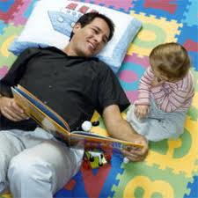
“Intentional” Shared Storybook Reading Curriculum
Strategies and Suggestions

Slide 58
Suggestions for Reading With Your Child
Getting Ready
A comfortable chair or couch for cuddling and close viewing
Twenty minutes of un-interrupted time
A good book or three
Pick books with rhymes, repetition, big unexpected events, problems to solve, and are PRINT salient
A happy frame of mind, have fun, laugh and smile
Ask “what do you think this story is going to be about?” let’s think about the title and the pictures/illustrations on the COVER and on the BACK and on the FIRST PAGE

Slide 59
Suggestions for Reading With Your Child
Read in your best, most expressive voice
Take on voices of characters
Use a somewhat slow rate
Be sure the child can see the print as you read, point to the print
Let the child hold the book or turn the pages
Observe , Wait , and Listen to your child
Use acoustic highlighting
Read the same books your child enjoys OVER and OVER
Let the child see you read often
Continue to read to your child even after he is a “reader”

Slide 60
Suggestions for Reading With Your Child
Let the child chime in on rhymes, repeats, refrains
Use auditory closure and “expectant lean” strategies
Let the child re-tell the story
Pose questions, “what would YOU do if…”
Plan a follow-up, related activity
Ask, “What do you think will happen next?”
Make distinctions between what is a letter, sound, word, sentence, and paragraph
Read first, without always showing the pictures

Slide 61
“Intentional” Shared Storybook Reading
Promotes Language and Literacy in the following areas:
Print Knowledge
Word Knowledge
Phonological Knowledge
Alphabet Knowledge
Narrative Knowledge
World Knowledge

Slide 62
Building Print Knowledge
How?

Slide 63
Print Knowledge
Provides a tool for translating the alphabetic code to decode words which facilitates reading comprehension
Understanding of
Printed letters
Printed words
Book conventions
Differences between print and pictures
Print carrying meaning
How to hold a book, turn the pages, and read from left to right

Slide 64
Activities to Encourage Print Awareness
Goal: to understand the role of words as carrying meaning
Storybook: Growing Vegetable Soup
(1987) by Lois Ehlert
Description: bold pictures with salient large print, sequence from planting, growing, harvesting, preparing, and eating vegetables, point to words when reading, comment about pictures, letters and words, these words tell the story, what does this word above the shovel say?, find another word that looks like this

Slide 65
Activities to Encourage Print Awareness
To identify environmental print and how print can change to represent meaning of vocabulary and words in songs
Storybook: The Wheels on the Bus
(1990) Paul O. Zelinsky
Description: the song is written along with illustrations of the bus moving through town with various environmental print signs. Point out print on signs and in speech bubbles. The words are written to represent the meaning of vocabulary such as “bumpety bump”, “round and round” and “up and down”.

Slide 66
Building Word Knowledge
How?

Slide 67
Word Knowledge
Understanding and using words of different form classes (nouns, verbs, adjectives, adverbs) and having a word repertoire for representing thoughts, needs interests, and ideas
An object is first described as big, then large, then gigantic and monstrous
Give greater precision in representing thoughts
Greater word knowledge improves reading comprehension

Slide 68
Activities to Encourage Word Knowledge
Goal: to understand body parts and senses and object functions “What do you do with your nose?” and “What do you smell?” and “What do you smell with?”
Storybook: My Five Senses
(1989) Alki
Description: A little boy takes a senses adventure seeing, hearing, tasting, smelling and touching various objects. These verbs are repeated throughout the story along with word “senses”. You can expand by teaching quality concepts with seeing (bright, shiny), hearing (loud, quiet), tasting (yummy, delicious, awful, yucky, sweet, sour), and touching (rough, smooth, bumpy, scratchy, silky). Teach body parts (eyes, ears, nose, hands, and mouth). Expand by playing Simon Says with directions such as touch your body part, or touch the rough one then taste the sweet one, etc.

Slide 69
Activities to Encourage Word Knowledge
Goal: to understand and use verbs and verb morphology and to increase verb vocabulary along with less familiar animal and animal part vocabulary
Storybook: Dinnertime
(2007) Jan Pienkowski
Description: animals appear to eat a frog (vulture, gorilla, tiger, crocodile, shark). Discuss monkey, gorilla, alligator, crocodile. They go away with past tense verbs (flapped, plodded through the jungle, bounded into the river, rubbed eyes and floated dozily out to sea, and gobbled him up). Point out parts of animals such as sharp teeth, pointy snout, whiskers, fangs, beak).

Slide 70
Building Phonological Knowledge
How?

Slide 71
Phonological Knowledge Tips for Parents
Draw attention to words, syllables, and sounds
Look for things we see that rhyme with bag.
Look for things that start with the /b/ sound.
Look for things that end with a /p/ sound.
Count the syllables in bicycle.
Count the sounds in hat.
How many words are in this sentence?
I will say the sounds in this word and you guess the word.
Look at the first letter of this word.

Slide 72
Activities to Encourage Phonological Knowledge
Goal: to segment words into syllables and blend parts of words
Storybook: If You Give a Pig a Pancake
(1998) by Laura Numeroff
Description: includes many compound words. Comment on word parts, clap parts of word, say parts of word separately, pan and cake are two little words, what happens when we put them together? (homesick, suitcase, backyard, mailbox, wallpaper) Where do I start reading on this page?

Slide 73
Activities to Encourage Phonological Knowledge
Goal: to demonstrate rhyme awareness and rhyme production
Storybook: Llama Llama Mad at Mama
(2007) Anna Dewdney
Description: few boldly printed words per page with rhyming words, comment on how the words rhyme, ask what words rhyme, think of other words that rhyme, use auditory closure and expectant lean to prompt the rhyming word. Point out the letters in the words that rhyme(signs/lines,fun/sun,car/are,treat/seat, feet/sweet, etc.) Some words are in bold. Generate rhyming words for these (whine/line,play/day).

Slide 74
Activities to Encourage Phonological Knowledge
Goal: to demonstrate awareness of and produce beginning sounds and rhyming and to understand consonant digraphs have two letters, but make one sound
Storybook: Sheep in a Jeep
(1991) by Nancy Shaw
Description: the sheep must find a way to make the jeep go. Comment on the beginning sounds of words, say the first sounds of words, say sheep slowly, shhhh…ok stop, that is first sound, find two words that start with the same sound, what letters make this sound? Which words rhyme? Talk about vowel digraphs ee and ea.

Slide 75
Building Alphabet Knowledge
How?

Slide 76
Alphabet Knowledge
Important aspect of literacy development during preschool and kindergarten
Alphabet knowledge is a good predictor of reading success
Amount of experience with books and print predicts alphabet knowledge in K and 1st grade
Alphabet knowledge are better able to benefit from phonics instruction in K

Slide 77
Activities to Encourage Alphabet Knowledge
Goal: to develop an interest in alphabet letters
Storybook: Dr. Seuss’s ABC
(1963) Dr. Seuss
Description: print-salient qualities: few words per page, repetitive print, and print embedded in the illustrations familiar for children. Letters are a prominent feature within the text and illustrations. Comment and point to letters.

Slide 78
Activities to Encourage Alphabet Knowledge
Goal: to identify several letters in his or her own name, to identify letters and match letters and print throughout the text, to identify uppercase and lowercase letters
Storybook: Alphabears, An ABC Book
(1984)Kathleen Hague
Description: few words in large print are used to tell stories about bears. The initial letter is bolded and in color. Talk about capital letters, uppercase letters, and lowercase letters. “Find all the B letters Look, this letter is e like in your name. Your name starts with this letter B.” Find letters within the pictures.

Slide 79
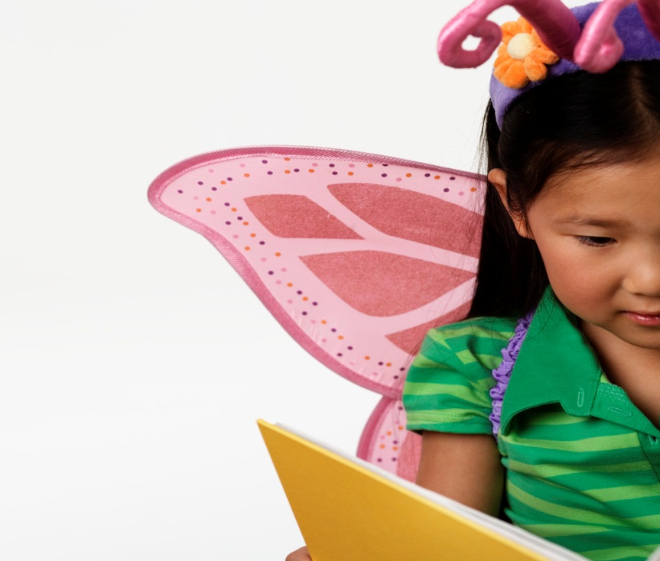
Building Narrative Knowledge
How?

Slide 80
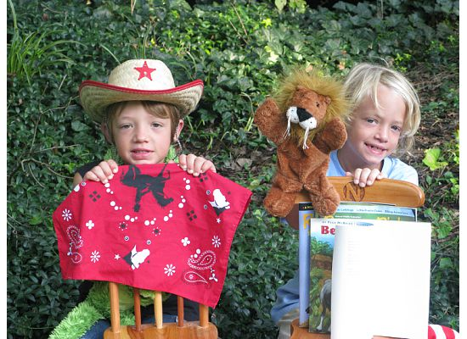
Narrative Knowledge
A child’s spoken and written descriptions of real or fictional events experienced in the past, the present, or the future
A narrative contains a minimum of two sequential independent clauses
Narratives are de-contextualized monologues (their focus is on people, characters, and events not in the present

Slide 81
Narration Objectives
Demonstrate understanding of stories
Retell, illustrate, or dramatize story that was read to child
Retell event which has happened to themselves or someone else
Share 1) conversational,
2) story/fictional, and
3) factual narratives

Slide 82
Teach Syntax for Narratives
Conjoiners (..and then,)
Labels and action words
Time indicators (a long time ago, sometimes, finally, usually, never, often)
Verb tenses
Connectives (although, however, but, regardless, when, so that)
Adverbs and adjectives

Slide 83
Activities to Encourage Narrative Knowledge
Goal: to discuss the sequence of events in a story
Storybook: The Very Hungry Caterpillar
(1994) by Eric Carle
Description: A caterpillar travels during the week in search of food before building a cocoon and becoming a butterfly. Adverbs allow elaboration on how and in what ways events occur as we tell narratives. Prompts child to recall events and predict what might happen next. Discuss days of the week. Discuss the highpoint in the story when he finally becomes a butterfly. Sequence the foods he ate from first to last in left to right order. Talk about the time and place in the story and how it changes.

Slide 84
Activities to Encourage Narrative Knowledge
Goal: to discuss the characters, time sequence, and setting of a story
Storybook: Only My Dad and Me
(2003) Alyssa Satin Capucilli
Description: This story chronicles a Dad and Son across different seasons of the year. It occurs across multiple settings. Who are the characters? Where are the characters? When did the characters do rake leaves, roll snowballs, take hikes, pick shells, celebrate. Discuss setting answers where? And when? Where are they now? When is this? That is the setting. The setting in this story changes.

Slide 85
Building World Knowledge
How?

Slide 86
World Knowledge
Children understand concepts such as:
Cultural diversity
Money
Character, emotions, and temperament
Nature, time, geography, weather
Life issues (birth, death, divorce)

Slide 87
Activities to Encourage World Knowledge
Goal: to understand different cultures
Storybook: The Legend of the Indian Paintbrush
(1988) Tomie dePaolo
Description: An American Indian boy learns to paint beautiful pictures on the plains using the colors of sunsets for inspiration. He leaves his paintbrushes on a hillside and the brushes multiply into plants of brilliant reds, oranges and yellows. Every spring the hills and meadows burst into bloom with “indian paintbrush blooms”. Discuss costumes and legends to discover. Reference print and beginning sounds. Extend world knowledge by conversing about the people and places in the illustrations.

Slide 88
Activities to Encourage World Knowledge
Goal: to understand characters, emotions, and temperment and to discuss loneliness, missing someone you love and not appreciating them when they are around
Storybook: Duck at the Door
(2007) Jackie Urbanovic
Description: A duck knocks on the door of a house full of animals late at night. He stayed behind when his flock flew south because he thought he would like the cold, but he didn’t and he was lonely.He stayed many months and became a nuisance to the other animals. They were excited for him to leave and join his flock…so, he left in the spring. The animals missed him and couldn’t wait for him to come back to stay the next winter. Discuss feelings of loneliness, missing someone, bothering people, etc.

Slide 89
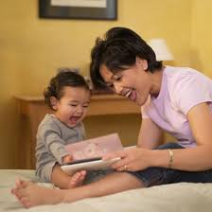
Can We Provide A Parent Curriculum to Improve the Quality of the Reading Experience?
Most certainly, “Yes!”

Slide 90
Literacy Curriculums
Target top down and bottom up processes
SPELL-Links
Phonological Awareness Kits
Lindamood LiPs
Lindamood Visualizing and Verbalizing
Lindamood Seeing Stars
Wisnia Kapp Reading Program
Wilson Reading System
The Source for Reading Fluency
Learning Ladder
Story Grammar Marker
Notes:
velvet

Slide 91
SPELL-Links to Reading and Writing (Wasowicz,Apel,Masterson,Whitney)
Spelling, reading, and writing activities that teach critical word study skills
Designed to improve spelling, reading decoding, fluency, vocabulary, comprehension, writing accuracy and organization
Spelling success includes
Phonological awareness (relize for realize)
Phonics (K is never spelled ck,cc at beginning of words)
Vocabulary( bare vs bear, question words start with WH)
Word parts (morphology, prefix, suffix, root words)
Mental images of words (MOIs: rope not roap)

Slide 92
Phonological Awareness Kits Lingui-System
Primary (ages 5-8)
Rhyming
Word Level: segmenting sentences and compound words, blending, isolation and deletion
Syllable Level: segmenting, blending, isolating, deleting
Phoneme Level: isolating, segmenting, blending, deleting, substituting
Grapheme level: blending, substituting, decoding and encoding
Intermediate (ages 8-13)
all the skills for Primary plus
Consonant and vowel digraphs
R controlled vowels
Silent e rule

Slide 93
Lindamood- Bell LiPPs
Weak phonemic awareness leads to difficulties in:
Recognizing same and different phonemes
Identifying the number and order of sounds in words
Blending sounds in words
Word attack
Spelling and syllabification
Developing an oral-motor, visual and auditory feedback system
Identify number and order of phonemes in syllables and words

Slide 94
Visualizing & Verbalizing Lindamood-Bell
Gestalt imagery is a primary factor basic to the process involved in oral and written language comprehension, language expression, and critical thinking.
Sensory information connects us to language and thought
“I make the movies when I read”

Slide 95
Visualizing and Verbalizing
Present and teach use of structure words to aid in DETAILED verbalizations
What Movement
Size Mood
Color Background
Number Perspective
Shape When
Where Sound

Slide 96
Vanilla Vocabulary Nanci Bell
Develops vocabulary through imagery-Visualizing and Verbalizing
Verbalize and gesture the visualization
Verbalize own sentence and definition
Experience words in context of story

Slide 97
Vanilla Vocabulary Examples
Brilliant: very bright or sparkling;
very, very intelligent
1)The queen’s brilliant diamond necklace flashed in the sun.
2) The moonlight was so brilliant that I could see my shadow on the ground behind me.
3)Albert Einstein was on of the most brilliant scientists whoever lived.
4) Dan gets good grades because he studies every night, not because he is brilliant.

Slide 98
Wisnia Kapp Reading Program (WKRP)
Multimodality
Sound Symbol Association
Nonsense Word Reading
Vowel and Consonant Digraphs
Syllables and Sounds
Six Syllable Types
Complex Orthographic Elements:
Consonant blends (bl, st, nd)
Consonant digraphs (sh, th, wh, ch)
Vowel digraphs (ea, ee, oa, oo)
Dipthongs (aw, au, ou, ow)
Phonograms (ight, oug, tion)

Slide 99
Six Syllable Types
Closed Syllable: drip
One vowel closed by one consonant=short vowel
Vowel Consonant –e: make
One vowel before the consonant, ends in e-long vowel
Open syllable: hi, me, po (re-posess)
One vowel ends the syllable= long vowel
Consonant –le maple, apple
At end of multi-syllabic word
R-controlled syllable- hard, fort, bird, her, burn
Vowel sound controlled by r
Vowel team or Double vowel- rain, boat, boil, shout
Includes vowel digraphs and dipthongs, a cluster of 2 or 3 vowels with 1 sound

Slide 100
Wilson Reading System
Twelve step reading and writing program beginning with phoneme segmentation
Sight word instruction
Vocabulary
Oral expressive language development and comprehension
Fluency
Reading Comprehension
Encoding and decoding
Stories and vocabulary for older students

Slide 101
Wilson Reading System Sample Lesson Vowel Digraph-Dipthong Syllable ai and ay
Word level for decoding and encoding
Say, afraid, drain, spray, faint, gait
Waist, complaint, raisin, payment, haystack, impairment, bail, defrayed
Sentence Level
The kids will organize a relay match at the park.
Ted will complain about the rain, but I am glad since it will help the garden.
I like to braid Terry’s long black hair.
Can you explain the delay in mail delivery?
Story Level
As Mitchell was on his way home, he saw a pile of items stacked for the dump truck. Mitchell went over to the pile. He saw an old train set . It was in fairly good shape! Etc.

Slide 102
Lindamood-Bell Seeing Stars
The letters of language are like the stars in the universe -------
Parts of a whole
“TEEOHEMOHDOUBLEAUROHDOUBLEYOU”
“How do you spell TOMORROW?”
Kids need to learn to sound out words AND they need to “see the word in their heads” like in spelling bees!

Slide 103
ACTIVITY: Seeing Stars: Symbol Imagery
The ability to visualize letters in words
What do you see when I say the word FIP? Look away and try to image the word in your mind
Now change FIP to FAP (you change the I to A)
Now change FAP to FRAP (you see the R come after the A)
What do you see when I say ENOUGH?
Look away to see and hear me. What letters do you see. Try saying them backwards

Slide 104
The Source for Reading Fluency: Automaticity
A term used in descriptions of reading fluency
If you are able to decode and comprehend at the same time, then one of those tasks has become automatic
Automaticity involves being able to visualize the text, understand a referent, understand the structure of the text

Slide 105
Fluent Readers
Quick
Accurate
Attend to punctuation
Use expression
Rhythm
Intonation
Phrasing

Slide 106
The Learning Ladder Elisabeth Wiig and Carolyn Wilson
Title: What does it tell me?
Theme: What do I already know about this?
Key Words: What are the main ideas?
Definitions: What words do I know/don’t know?
Details: What details do I remember?
Comparisons: How are words or ideas are alike or different? Changes: What changes do I see?
Applications: How does this apply to me?
Main Ideas: What are the main ideas and problems?
Predictions: What can I predict, create, or imagine?

Slide 107
Story Grammar Marker Maryellen Rooney Moreau and Holly Fidrych-Puzzo
Generate or Re-tell a Story including:
Character
Setting
Initiating Event/Problem
Internal Response
Plan
Attempts to Solve Problem
Direct Consequence/ Lesson Learned
Resolution

Slide 108
Use of Grade-Level Standards
Differ by state, territory, country
Generally can access online
Encourage parents to download standards
Encourage parents to ask questions of teachers
Important to go back
Assess” knowledge and skills that the child may have missed learning
Take a deeper look
Return again and again
Notes:
gayla

Slide 109
What You Have Learned
Grade Level Reading Campaign
Reading Realities for All Children: Facts are Facts
“Literacy for Littles” with Hearing Loss: Things to Consider
Literacy Definitions
Literacy Development
Effective Reading Strategies for Parents Curriculum
“Intentional Shared Storybook Reading” teaches
Print Knowledge
Word Knowledge
Phonological Knowledge
Alphabetic Knowledge
Narrative Knowledge
World Knowledge
Literacy Curriculums

Slide 110
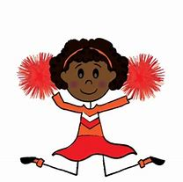
One More Time: 3 by 3
Literacy development is multi-faceted
The process should begin as early as possible
Follow developmental timelines
Assess literacy skills
Develop appropriate goals and benchmarks
Apply explicit instruction on literacy
Celebrate successes!
Complete third grade ready for “reading to learn”

Slide 111
References
Scaffoldlng with Storybooks: A Guide for Enhancing Young Children’s Language and Literacy Achievement, Laura M. Justice and Khara L. Pence, 2005
Shared Storybook Reading: Building Young Children’s Language and Emergent Literacy Skills, Helen K. Ezell and Laura M. Justice, 2005
Ellen Estes. M.S. Curriculum and Instruction Specialist at Atlanta Speech School, 2006

Slide 112
References
The Campaign for Grade-Level Reading:
http://gradelevelreading.net/

